Slide 1
Security Plan
By bradley

Slide 2


Identify potential risks
Logins, passwords and devices for example
Things like malware, phishing attacks, unauthorized access
Assess the likelihood and impact of each risk and prioritize based on their severity

Slide 3

Develop security policy's and procedures
Develop clear security policies and procedures for accessing and using the business network and programs
Things such as password policies, data backup procedures, multifactor authentication, and data encryption.

Slide 4


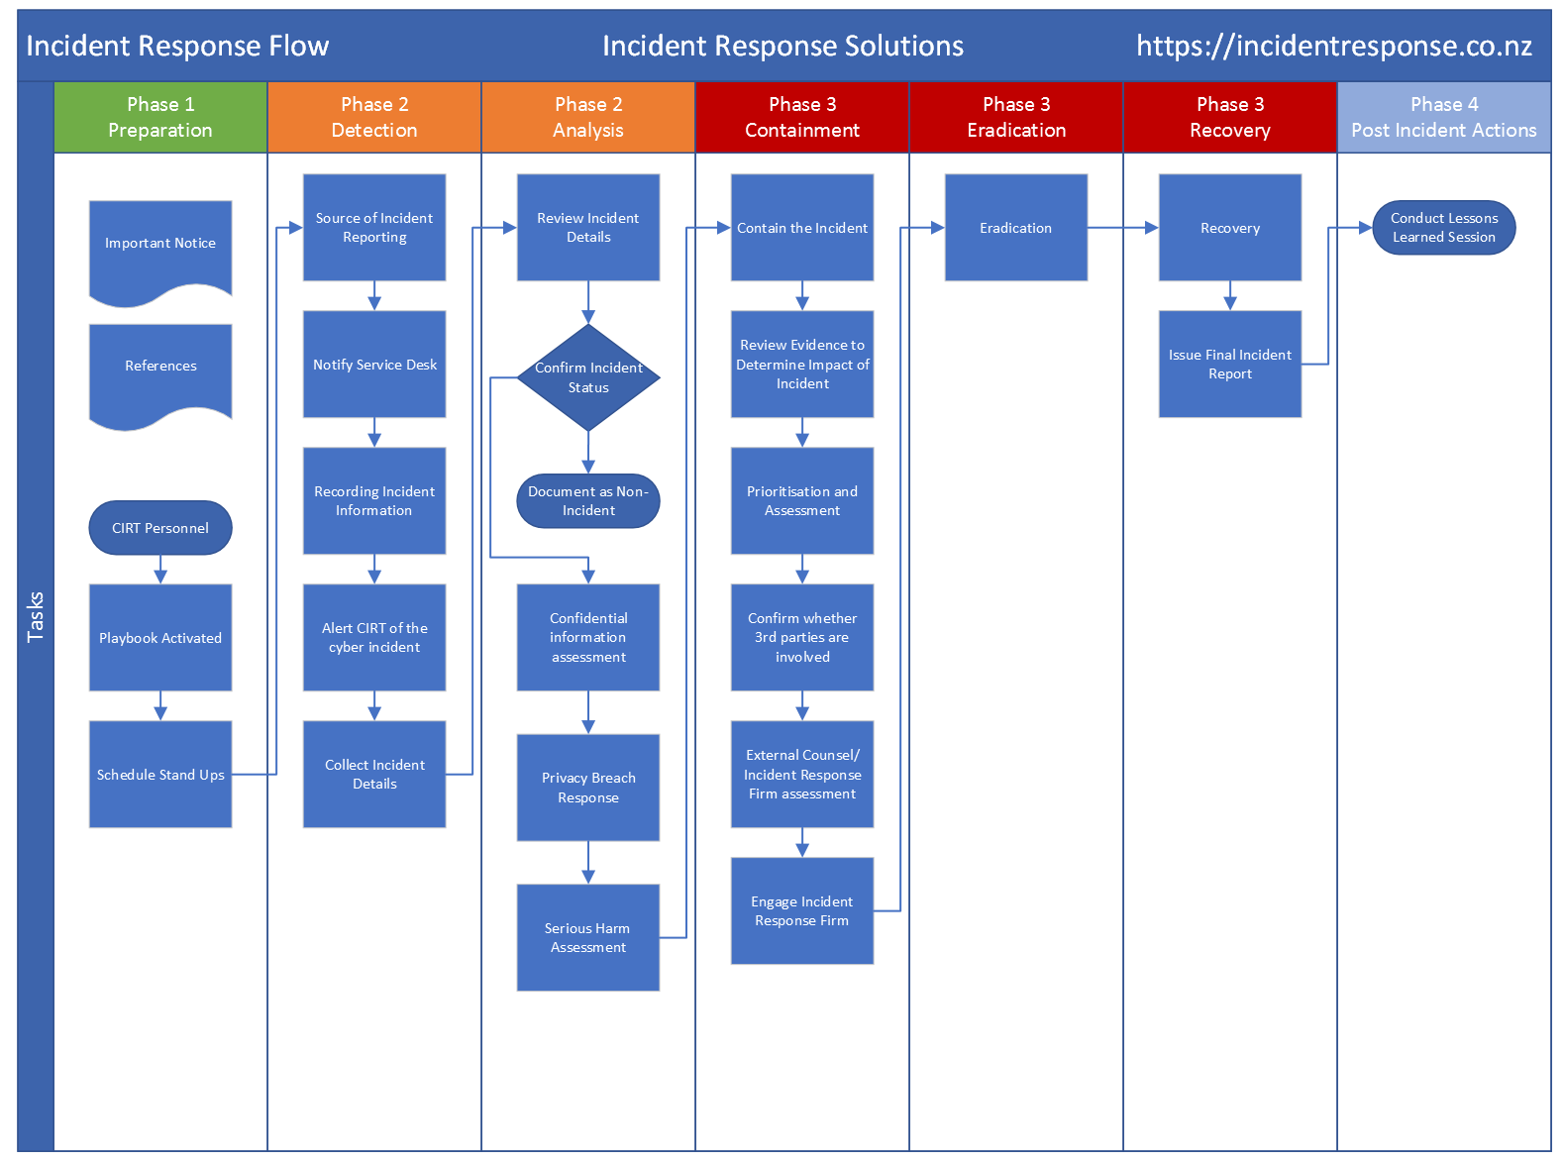
Incident response plan
https://www.google.com/url?sa=i&url=https%3A%2F%2Fincidentresponse.co.nz%2Fincident-response-plan%2F&psig=AOvVaw3bULqx63nBYE0laBwMZEzX&ust=1680773617955000&source=images&cd=vfe&ved=0CBAQjRxqFwoTCNjftOW3kv4CFQAAAAAdAAAAABAI

Slide 5
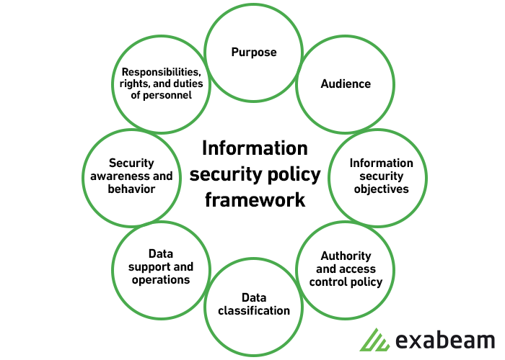
https://discuss.boardinfinity.com/t/what-are-the-8-components-of-security-plan/9966

Slide 6
Purpose
Keep information private
Keep people safe
Keep website running

Slide 7

Audience
Customers
Davey

Slide 8
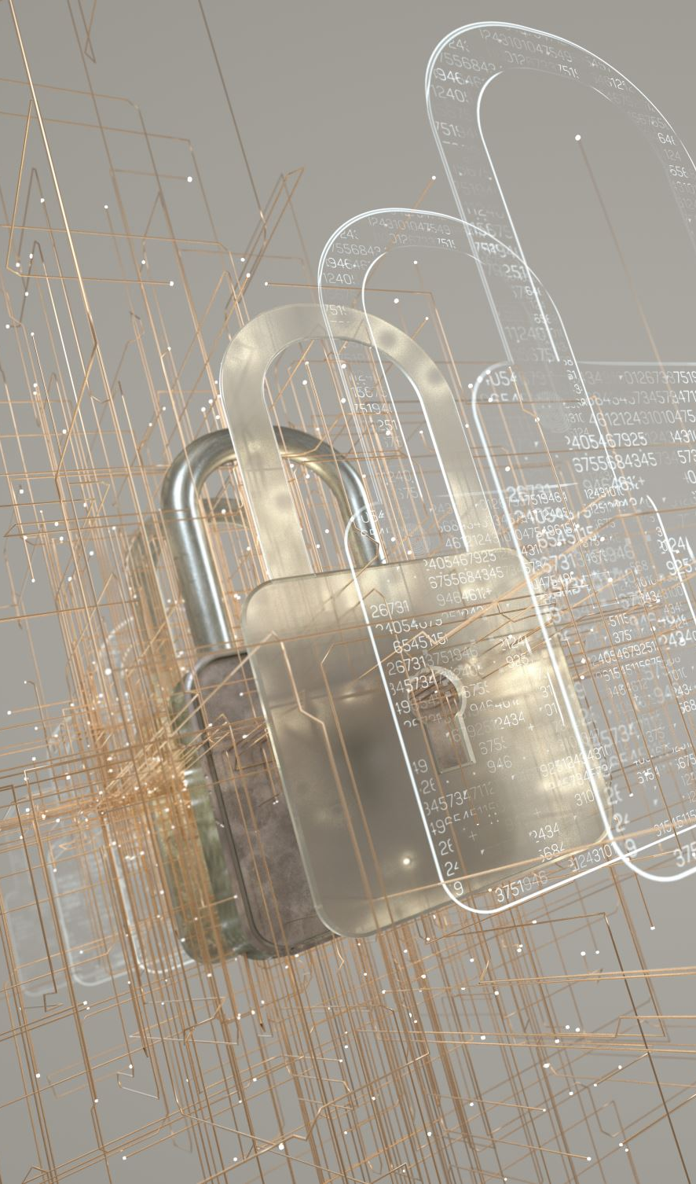
Information security objectives
Ensure confidentiality, integrity, and availability of information

Slide 9
Authority and access control
Davey for admin
Us for admin
Users for just their info
No one access to full card details or stuff like that

Slide 10
Data classification
Encrypted passwords and cards
Customer details such as full names and emails private

Slide 11
Data support
We need backups
Only can access data and stuff when needed
Good database design which our designers are the best ☺

Slide 12

Security awareness and behaviour
Prep davey and others about security plan/backups
Implement a password policy for everyone so they are tough
https://www.passwordmonster.com/

Slide 13
Responsibilities, rights, and duties
Who can access what information?
Networker to look out for security = me
Everyone has a duty to cyber security.

Slide 14

Rinse and repeat
Always keep up on and going round the security plan

Slide 15
Thanks
BRADLEY

